Slide 1
THE JOYLESS

Slide 2
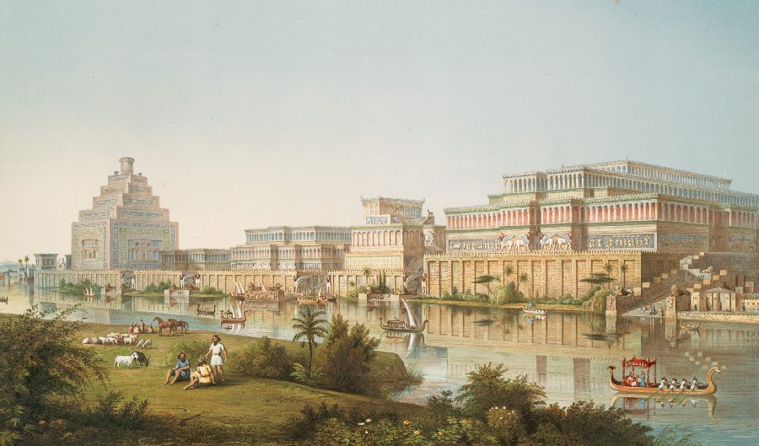
Jonah the Joyless

Slide 3
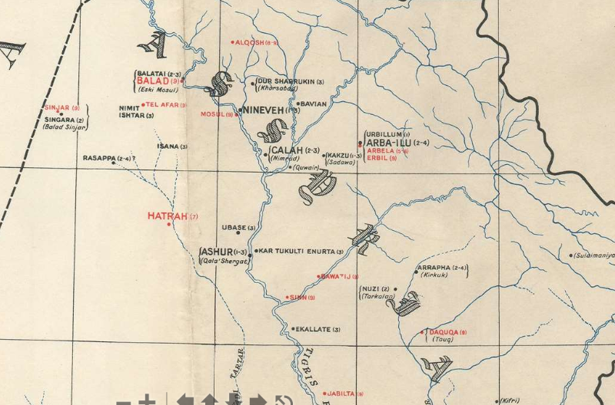
Jonah the Joyless

Slide 4
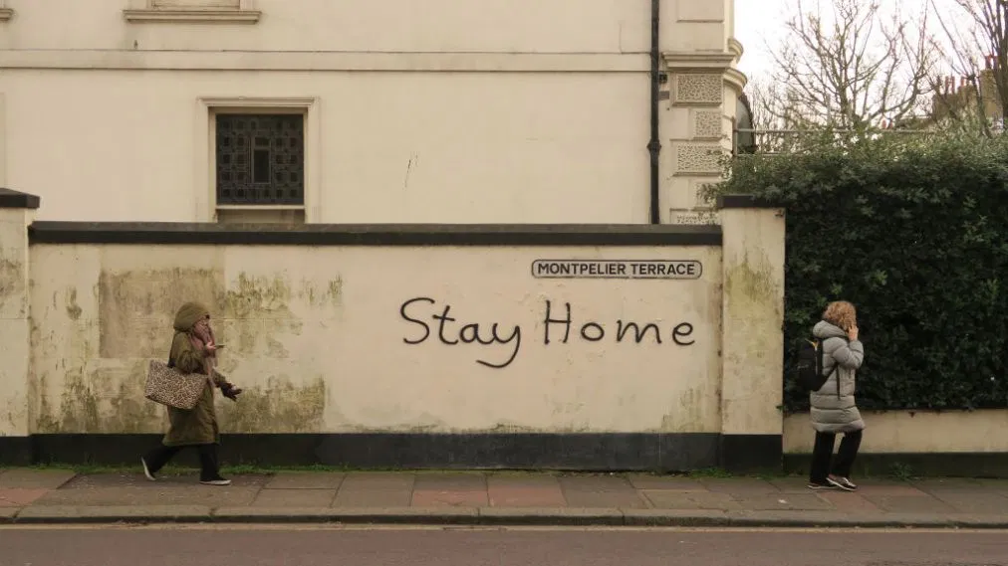
Jonah the Joyless

Slide 6
Jonah the Joyless
(Rom 1:16) “For I am not ashamed of the gospel; it is the power of God for salvation to everyone who has faith …”

Slide 7
Jonah the Joyless
The eternal gospel: ‘Fear God and give him glory, for the hour of his judgment has come; and worship him who made heaven and earth, the sea and the springs of water.’ : (Rev 14:6-7 NRSV)

Slide 8
THE JOYLESS

